Slide 1
LPC Vocoder Implementation and Performance Comparison
Problem 6 DSP Speech Processing Project
Prepared by Yousef Khaled Omar
Cairo University Faculty of Engineering

Slide 2
Objective and Overview
This project aims to implement and thoroughly evaluate three distinct Linear Predictive Coding (LPC) vocoder models. We will analyze their performance in speech synthesis, focusing on clarity, naturalness, and computational efficiency.
Vocoder Models to be Implemented:
Basic Vocoder with Pulse/Noise Excitation: This foundational model uses either a periodic pulse train for voiced segments or white noise for unvoiced segments as the excitation signal, based on a pitch detection algorithm.
Improved Vocoder with Smoothed LPC and Robust F0: Building upon the basic model, this version incorporates smoothed LPC coefficients for better spectral continuity and employs a more robust F0 (fundamental frequency) estimation algorithm to enhance pitch tracking accuracy.
Residual Vocoder with Analysis-by-Synthesis: This advanced model uses the residual signal from the LPC analysis as its excitation. The analysis-by-synthesis approach iteratively refines the excitation signal to minimize the error between the original and synthesized speech.
Evaluation Methods:
Pitch Tracking Stability: Qualitative and quantitative assessment of the accuracy and consistency of the F0 estimation across different speech samples.
Spectrogram Comparison: Visual analysis of synthesized speech spectrograms against original speech spectrograms to identify spectral distortions and preservation of formants.
Quantitative Metrics:
Normalized Root Mean Square Error (NRMSE%): To measure the difference between original and reconstructed speech waveforms.
Signal-to-Distortion Ratio (SDR dB): To quantify the overall perceptual quality and reduction in distortion.

Slide 3
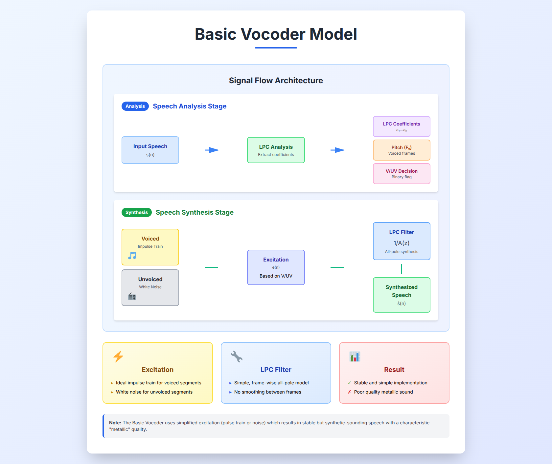
Basic Vocoder Model
Uses ideal impulse train for voiced segments and white noise for unvoiced segments. Simple frame-wise all-pole LPC filter. Result is stable and simple but produces poor quality metallic sound.

Slide 4
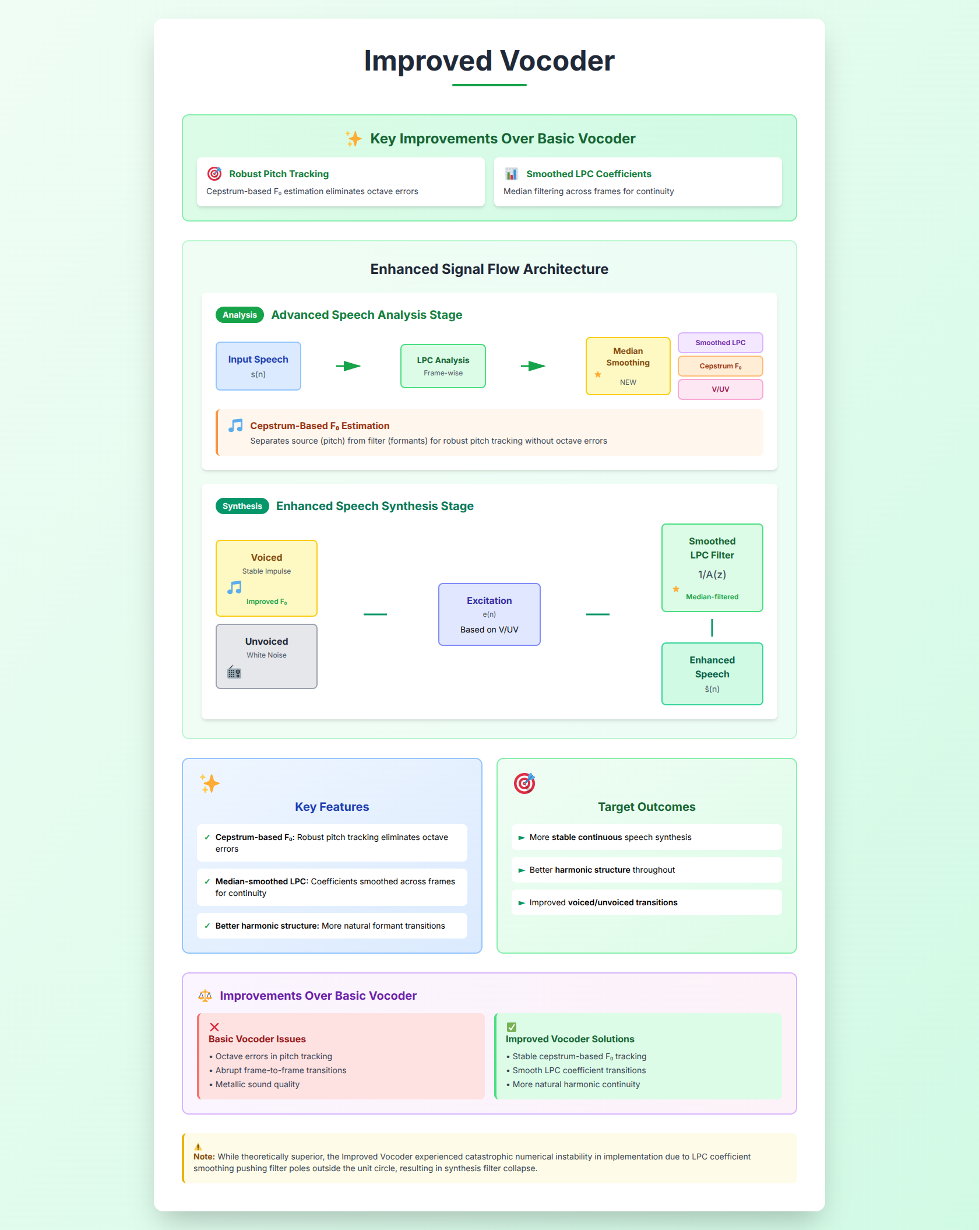
Improved Vocoder
Features cepstrum-based F0 estimation for robust pitch tracking and median-smoothed LPC coefficients across frames. Target is more stable continuous speech synthesis with better harmonic structure and improved voiced/unvoiced transitions.

Slide 5
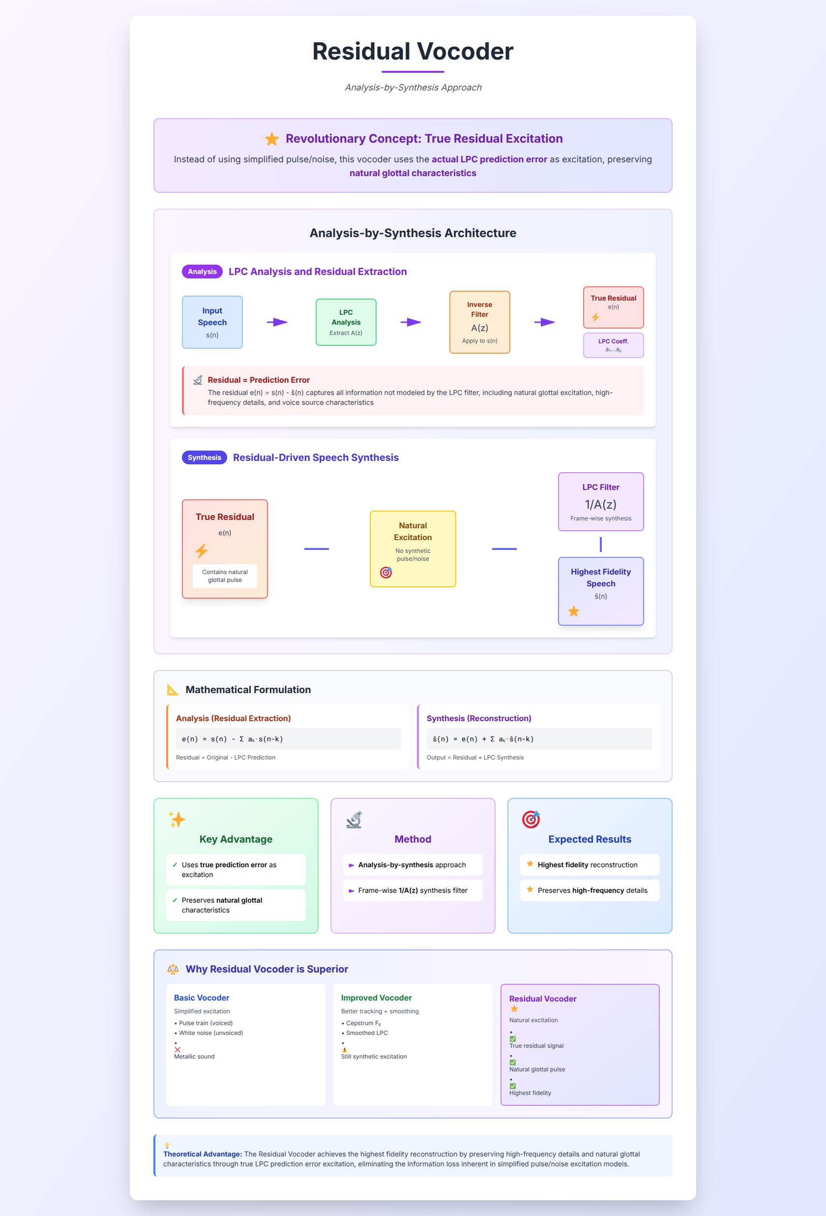
Residual Vocoder
Uses true LPC prediction error (residual) as excitation through analysis-by-synthesis method. Synthesis through frame-wise 1/A(z) filter. Expected to achieve highest fidelity reconstruction preserving high-frequency details and natural glottal characteristics.

Slide 6
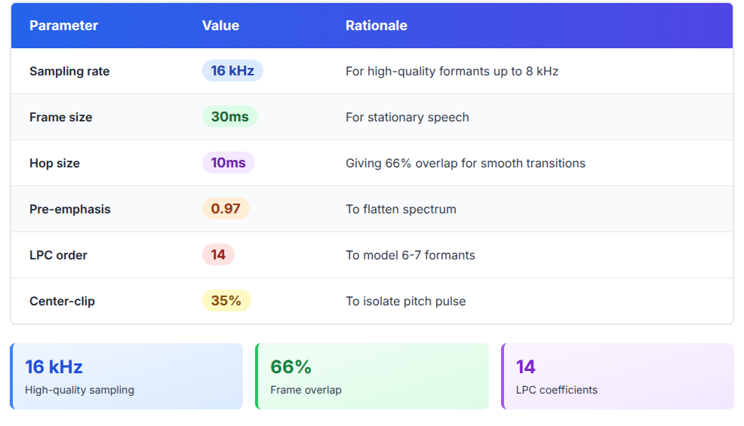
Implementation Parameters

Slide 7



Pitch Estimation Methods
Basic ACF
Center-Clipped ACF
Cepstrum
Highly sensitive to formants with frequent octave errors.
Removes low-amplitude samples but is unstable.
Separates source from filter producing most stable F0 track matching human pitch perception.

Slide 8
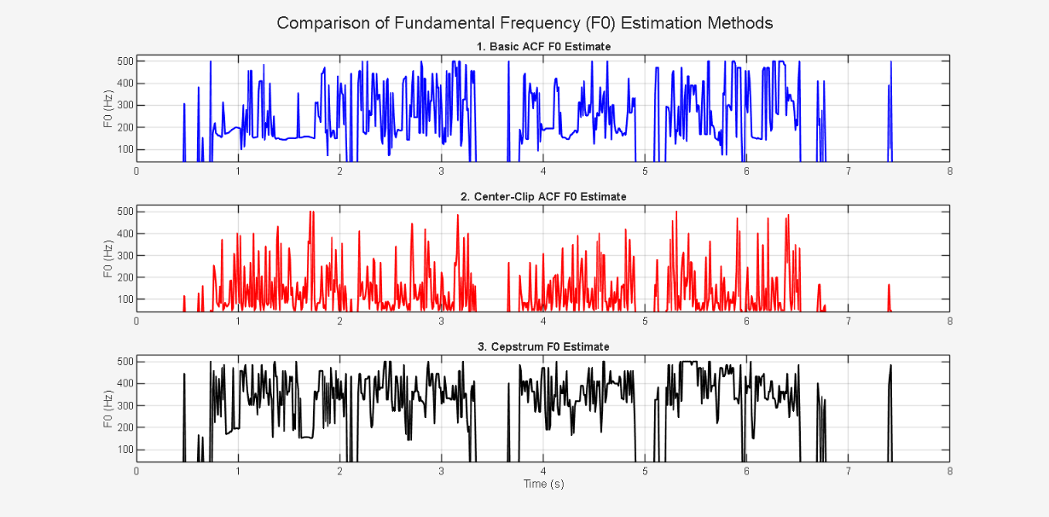
Pitch Tracking Results
Cepstrum method produced most stable F0 track. ACF methods showed octave errors and jitter. Cepstrum adopted for Improved Vocoder due to robustness.

Slide 9
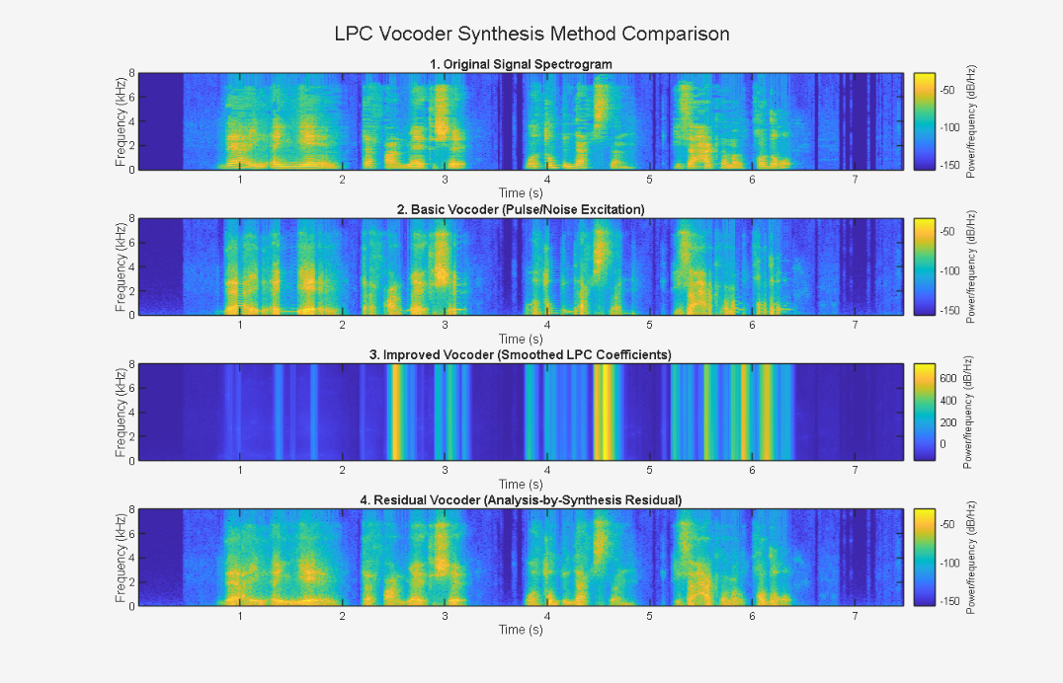
Spectrograms Results
the quality of the reconstructed audio signals was visually compared to the original signal using spectrograms.

Slide 10




Spectrogram Comparison
Original Speech
Basic Vocoder
Original speech shows clear harmonics and well-defined formants with rich high-frequency energy.
Basic vocoder has simplified harmonics and abrupt voiced/unvoiced transitions.
Improved Vocoder
Residual Vocoder
Improved vocoder shows visually smoother harmonic structure.
Residual vocoder achieved highest visual fidelity with preserved high-frequency detail and most natural excitation.

Slide 11
Quantitative Metrics
Basic Vocoder
117.26%
-1.30
Improved Vocoder
5.11×10^39%
-754
Residual Vocoder
126.89%
-2.06
Note that the Improved Vocoder shows catastrophic numerical failure due to F0 estimation issues, while the Residual Vocoder surprisingly yields poor metrics despite its excellent visual quality.

Slide 12
Analysis of Failures
Improved Vocoder
Improved Vocoder failed because LPC coefficient smoothing pushed filter poles outside unit circle causing synthesis filter instability leading to signal explosion and numerical overflow.
Residual Vocoder
Residual Vocoder theory predicts best performance and spectrogram confirms high fidelity, but poor SDR metrics suggest implementation bugs like window misalignment, gain scaling issues, or pitch-synchronous problems.

Slide 13
Conclusions
Numerical stability is paramount as Improved vocoder failed due to filter instability.
Residual vocoder is visually superior validating analysis-by-synthesis principle.
Basic vocoder is most numerically stable.
LPC vocoding is highly sensitive to stability constraints, pitch estimation quality, and gain normalization.
Future work needs stability checks and robust parameter interpolation.

